Slide 1
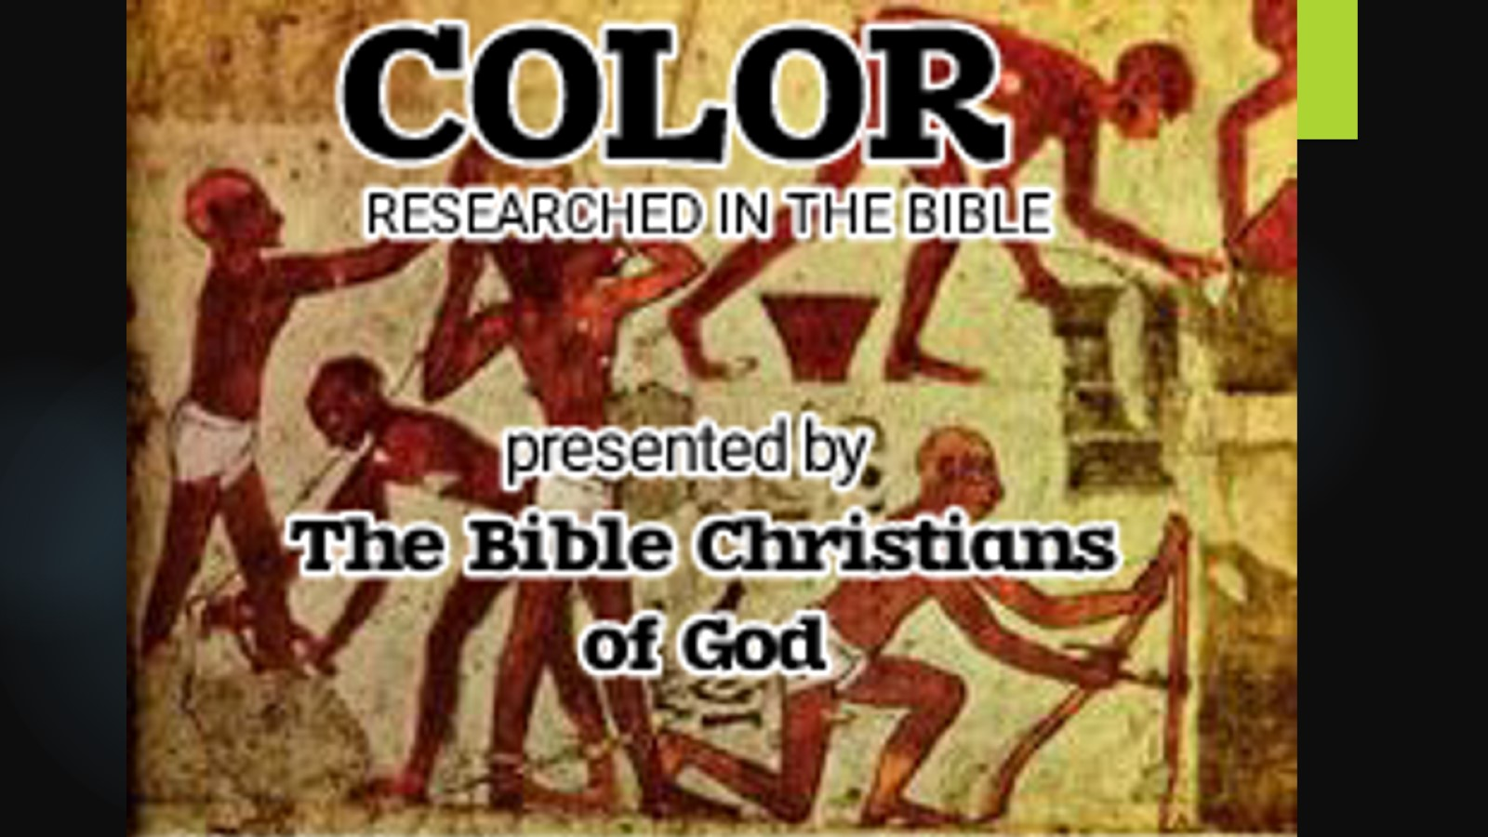

Slide 2
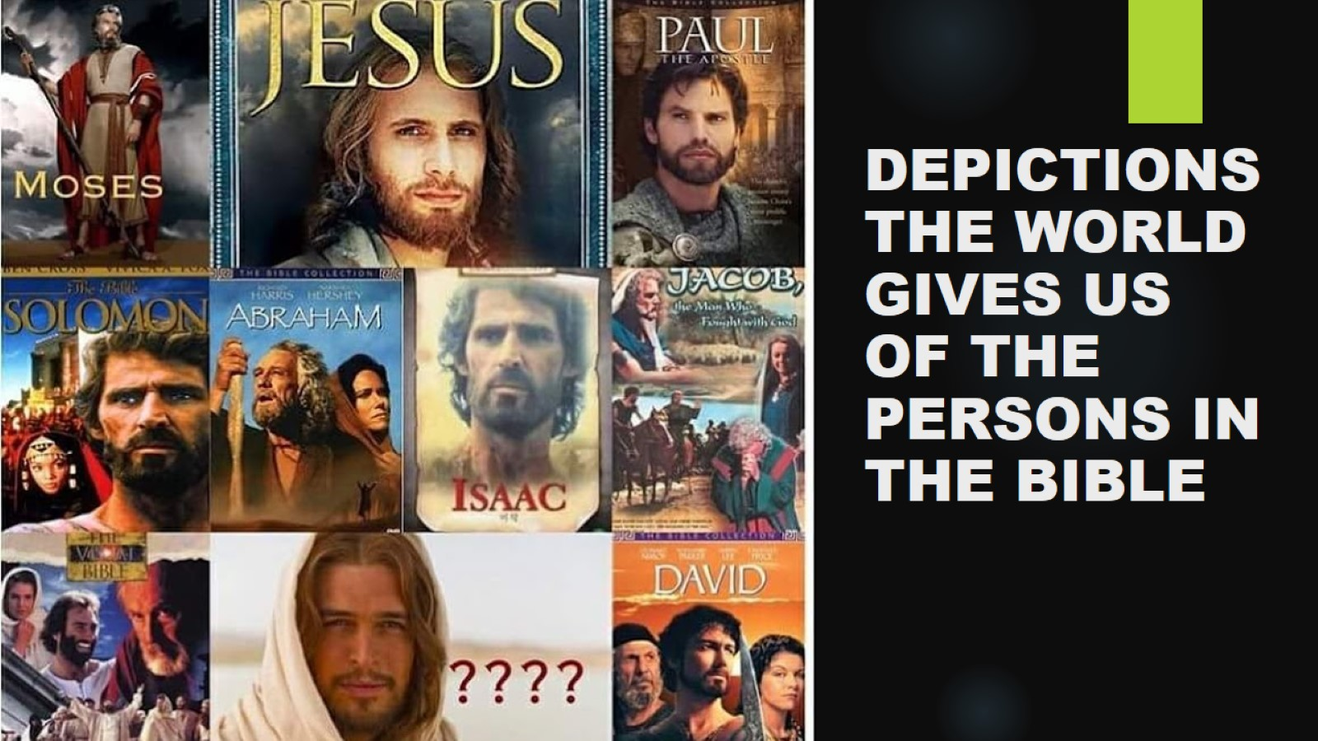
DEPICTIONS THE WORLD GIVES US
OF THE PERSONS IN THE BIBLE

Slide 3
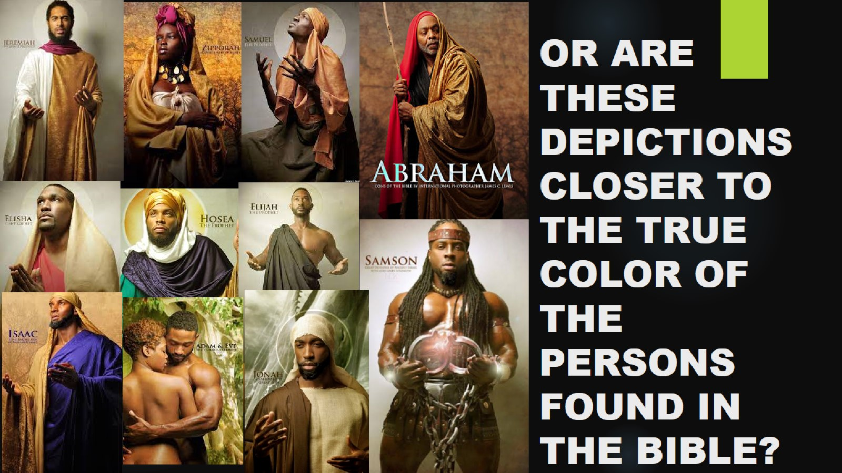
OR ARE THESE DEPICTIONS CLOSER TO THE TRUE COLOR OF THE PERSONS FOUND IN THE BIBLE?

Slide 4
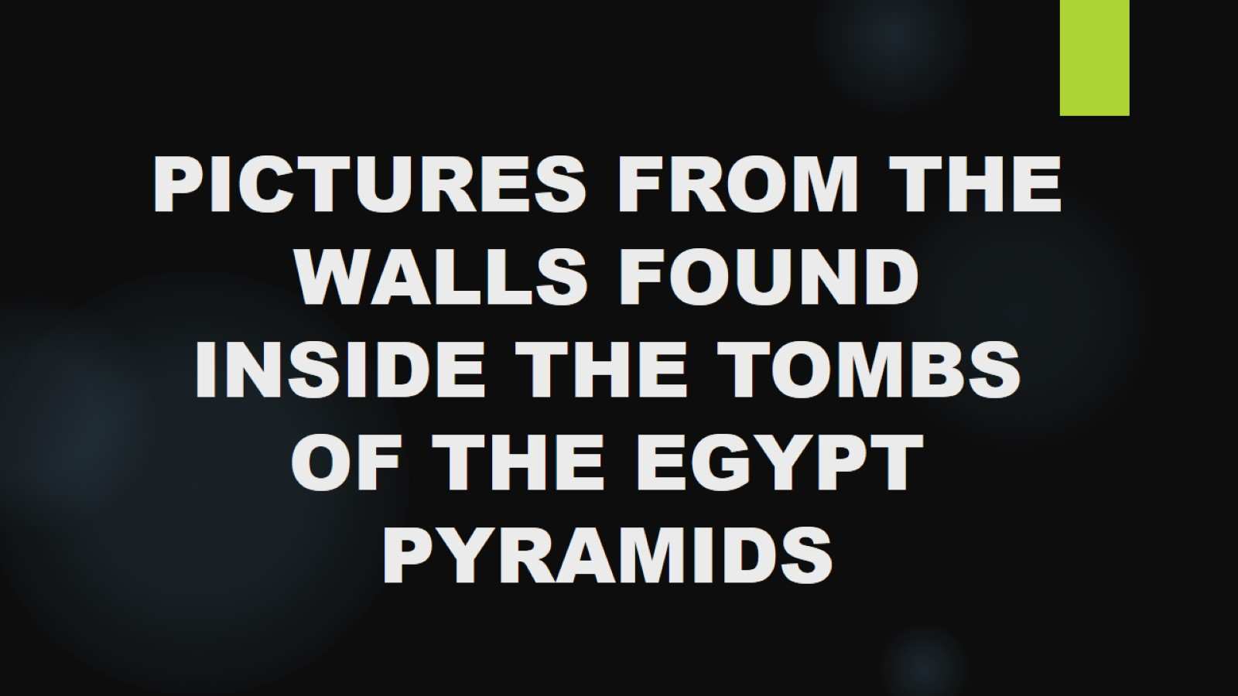
PICTURES FROM THE WALLS FOUND INSIDE THE TOMBS OF THE EGYPT PYRAMIDS

Slide 5
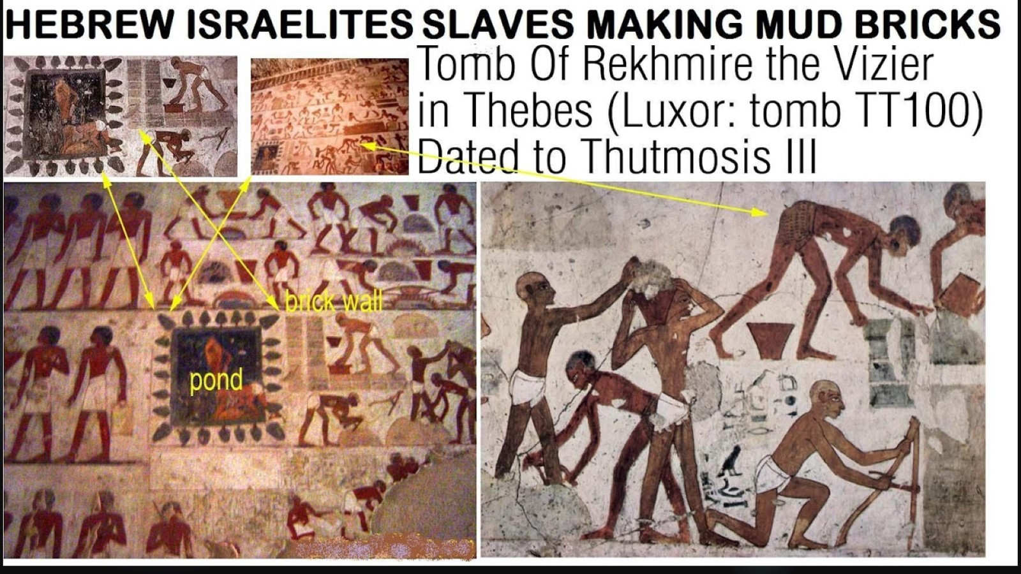

Slide 6
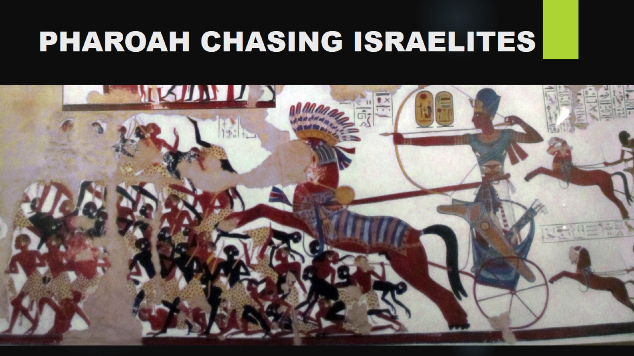
PHAROAH CHASING ISRAELITES

Slide 7
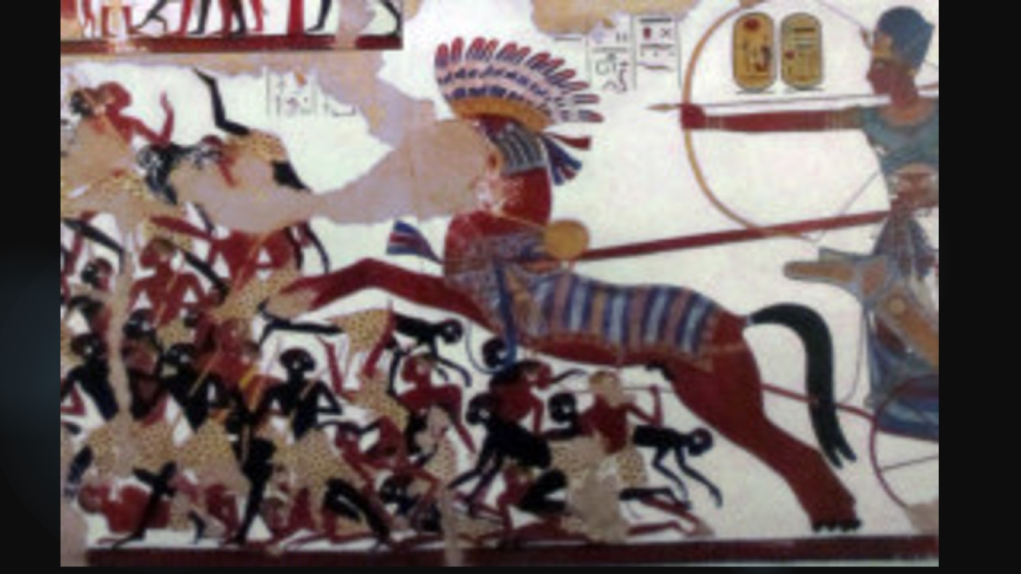

Slide 8
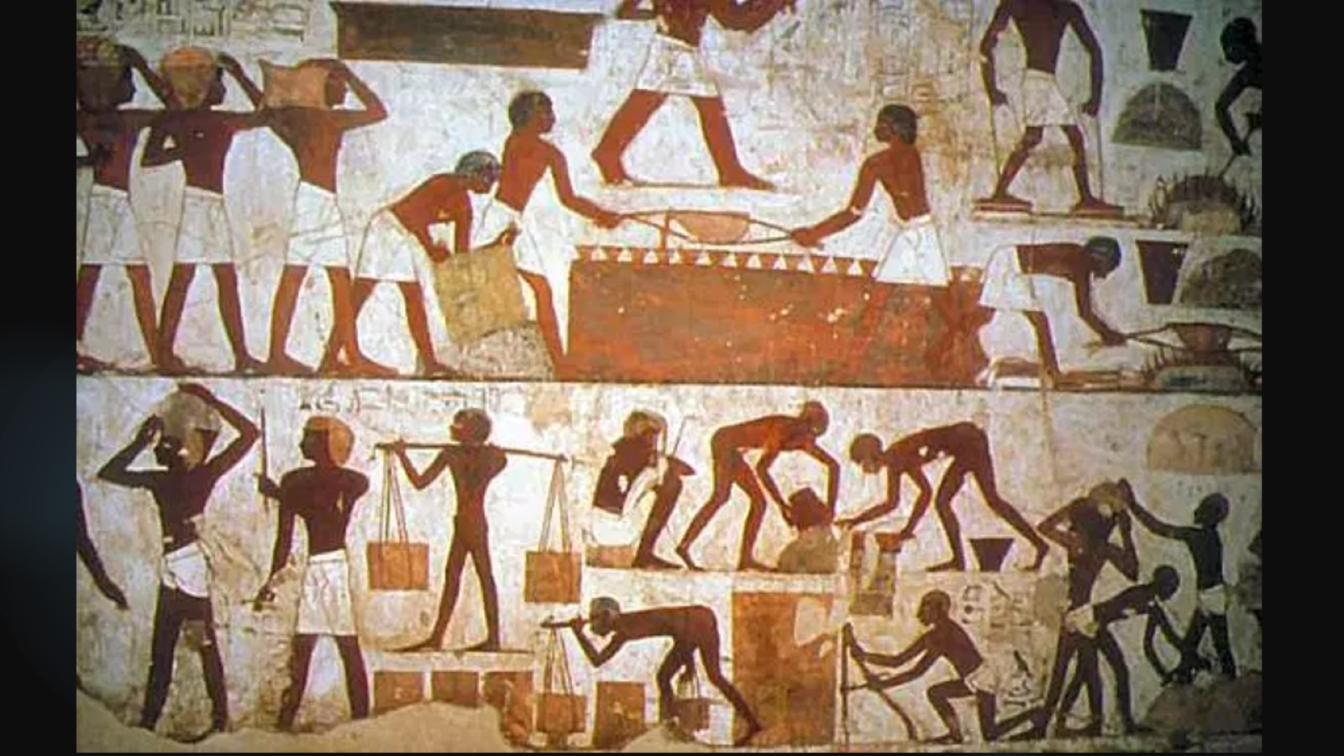

Slide 9
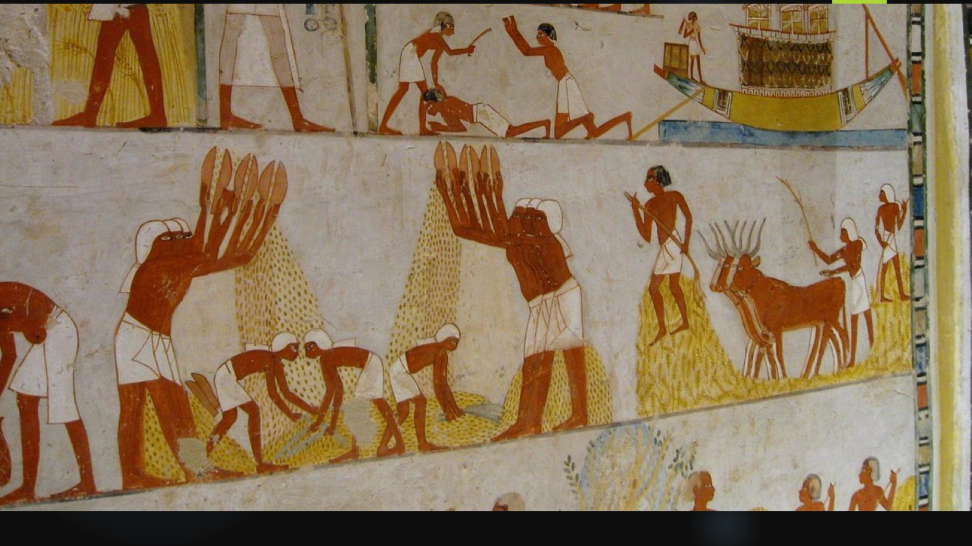

Slide 10
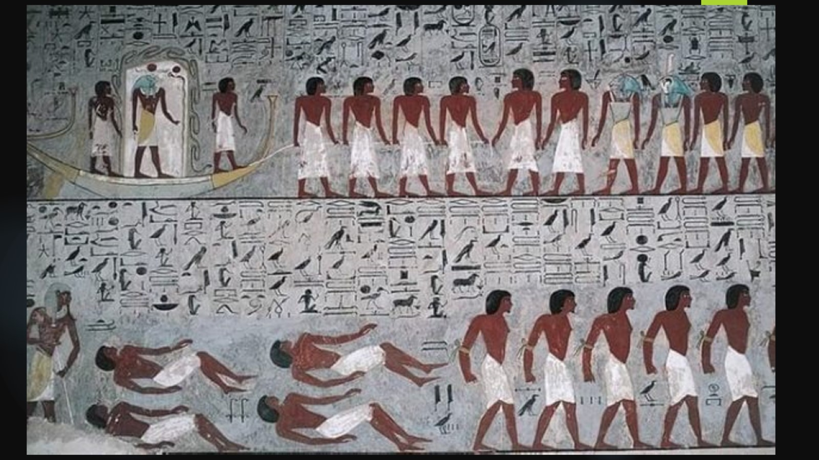

Slide 11
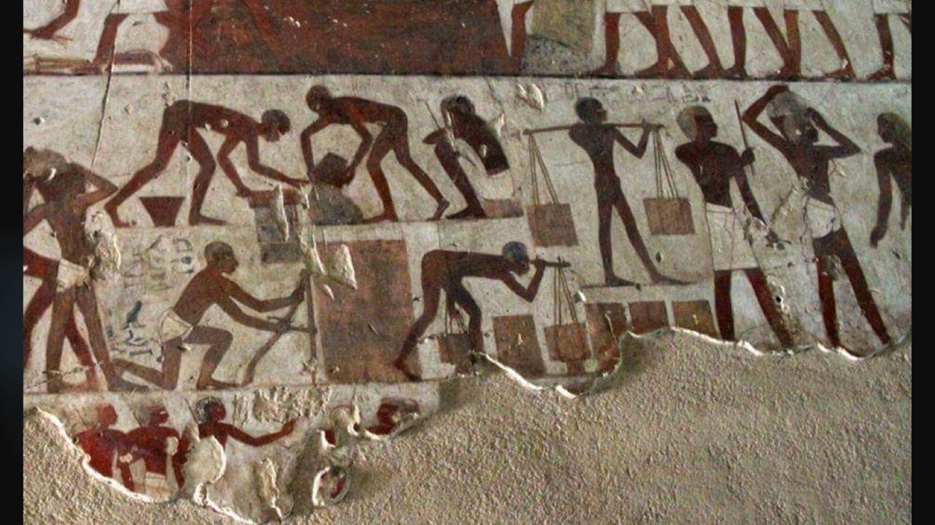

Slide 12
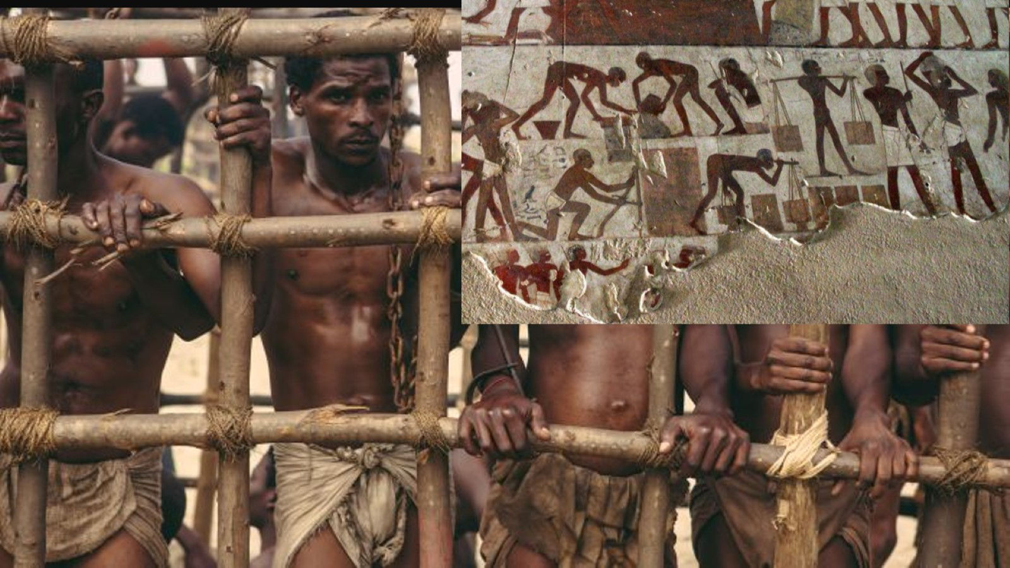

Slide 13
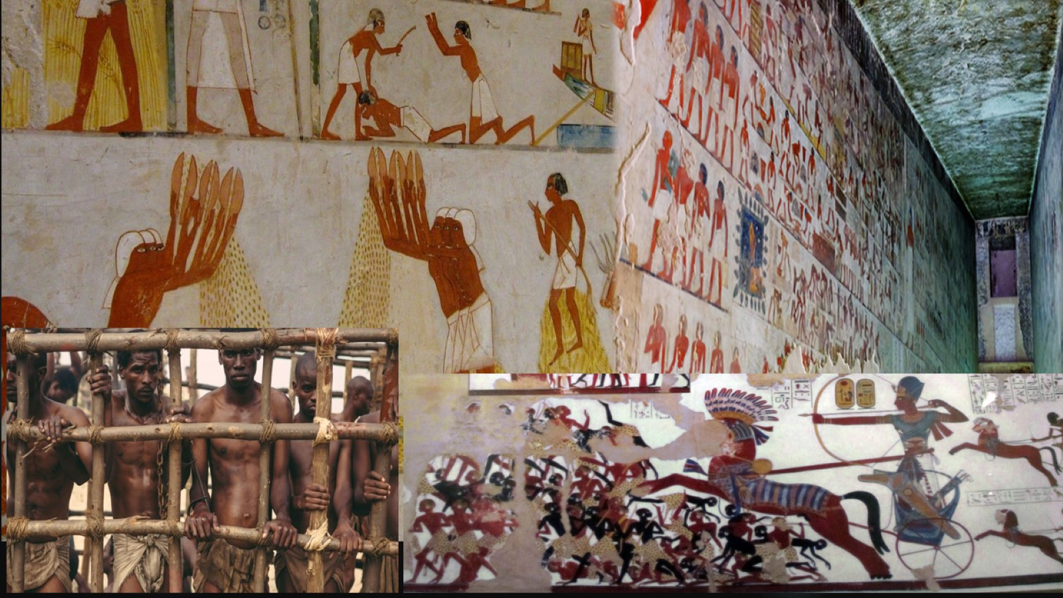

Slide 14
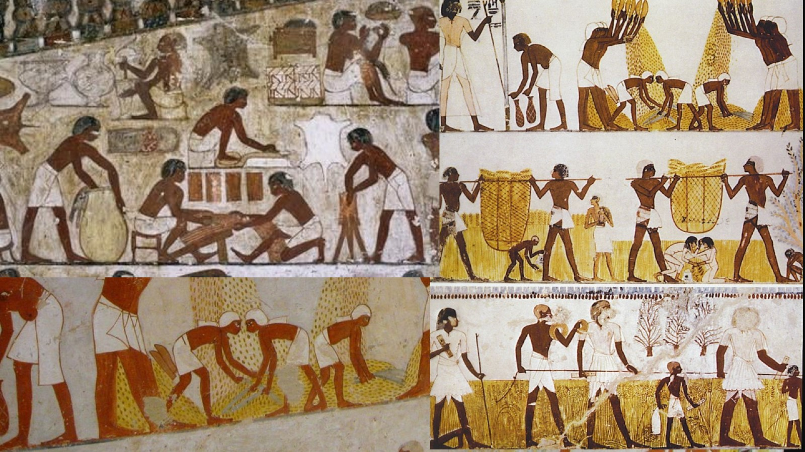

Slide 16
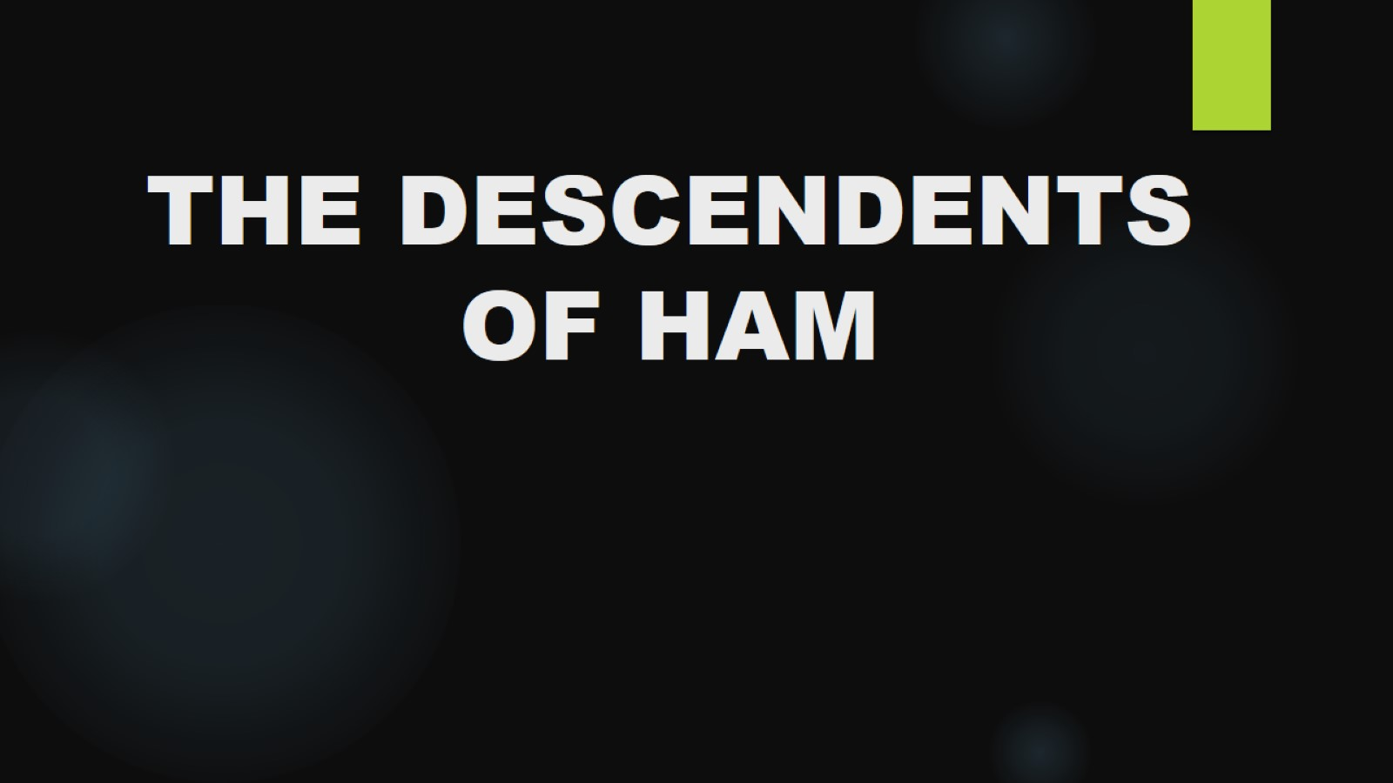
THE DESCENDENTS OF HAM

Slide 17
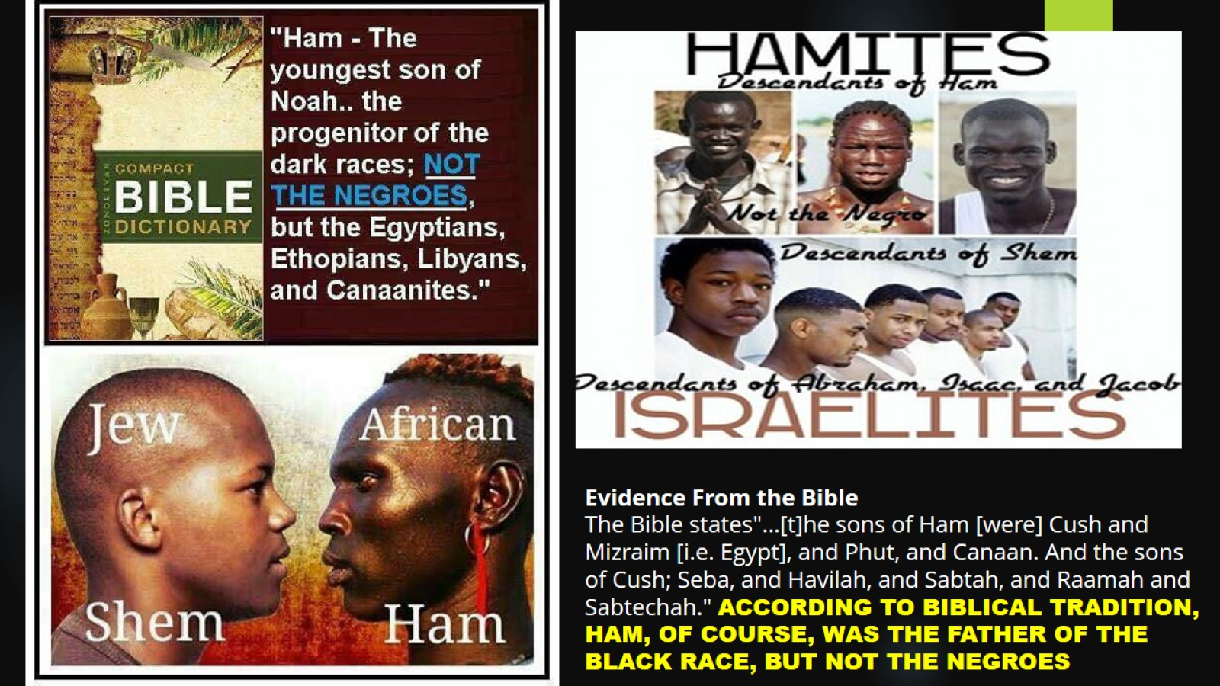

Slide 18
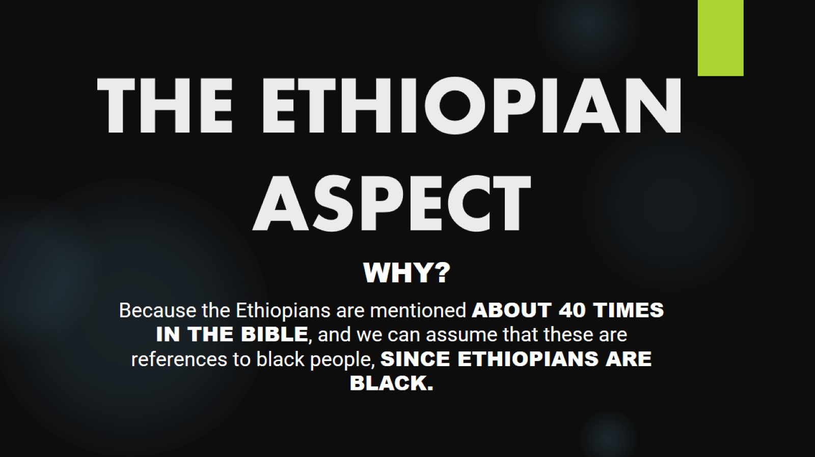
THE ETHIOPIAN ASPECT

Slide 19
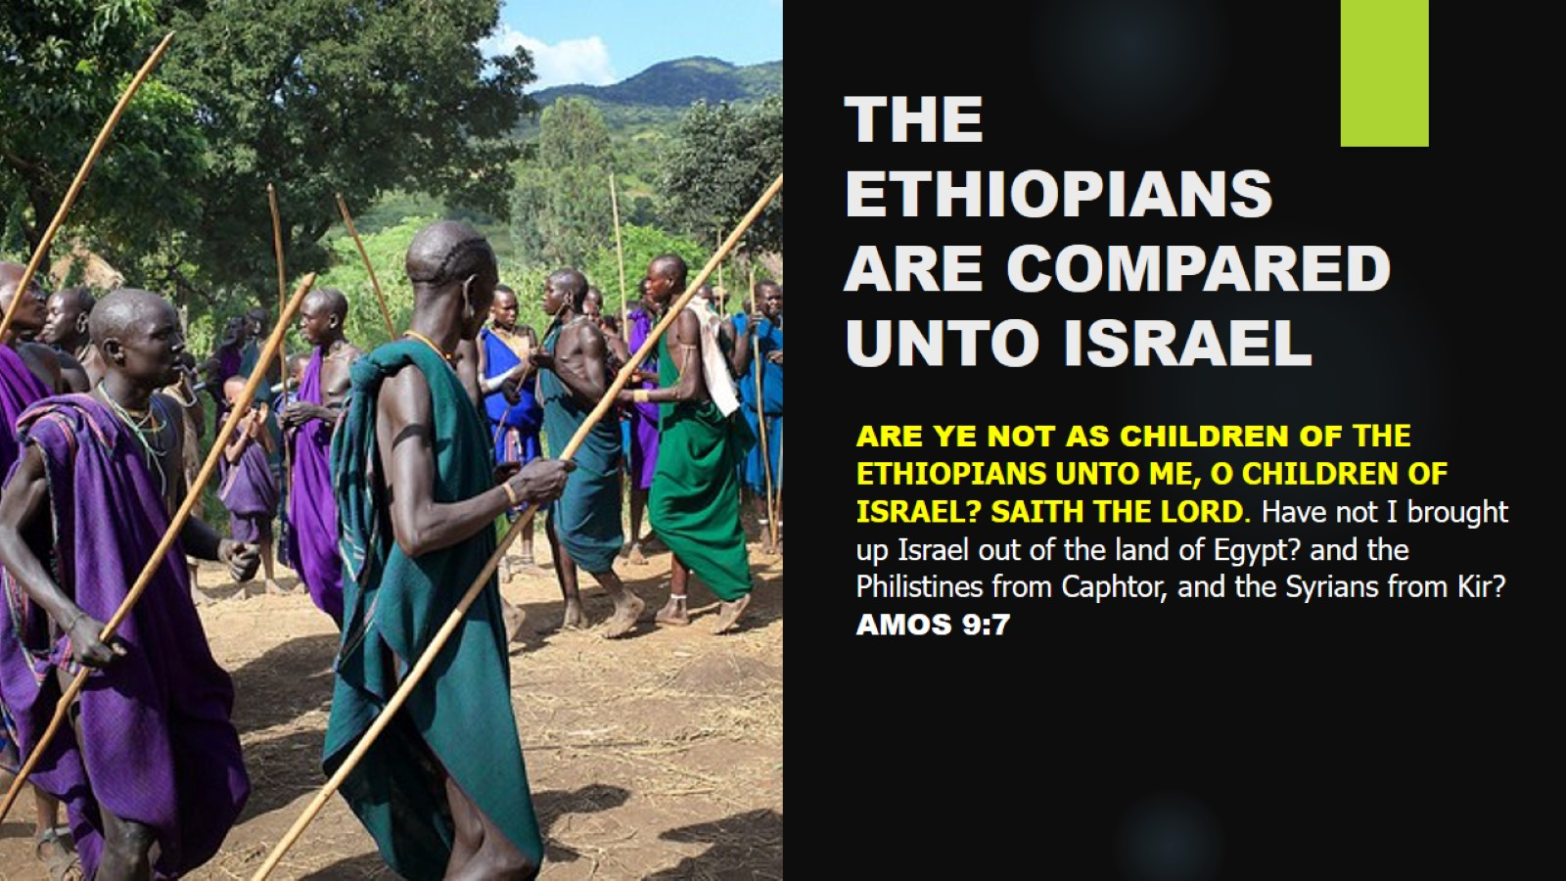
THE ETHIOPIANS
ARE COMPARED
UNTO ISRAEL

Slide 20
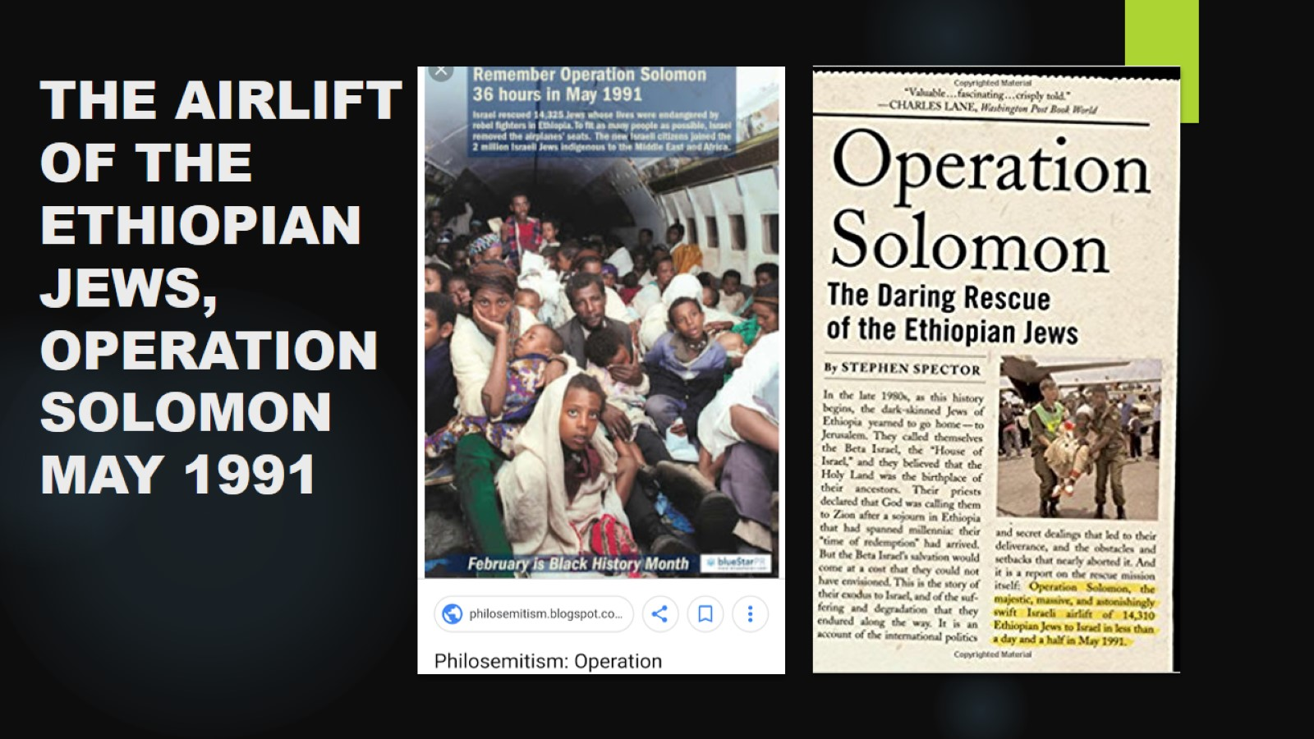
THE AIRLIFT
OF THE ETHIOPIAN JEWS,
OPERATION
SOLOMON
MAY 1991

Slide 21
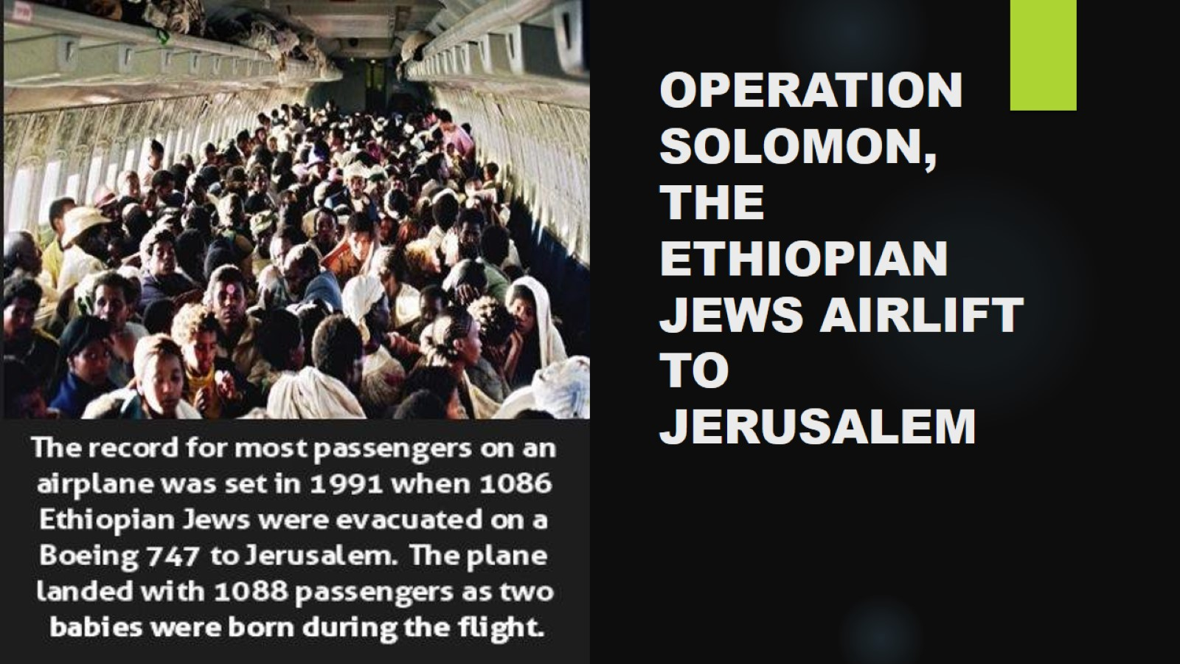
OPERATION
SOLOMON,
THE ETHIOPIAN JEWS AIRLIFT TO JERUSALEM

Slide 22
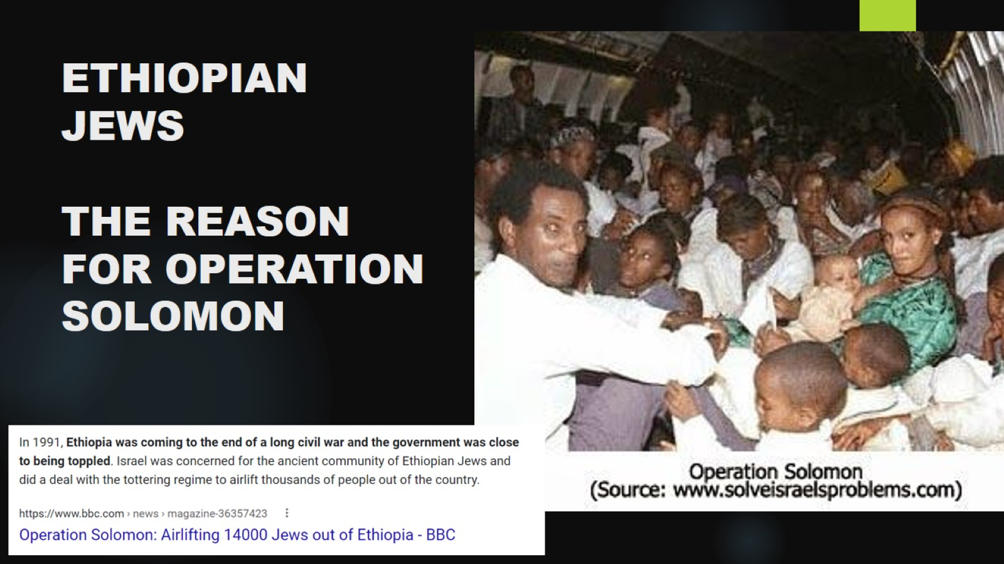
ETHIOPIAN
JEWS
THE REASON FOR OPERATION SOLOMON

Slide 23
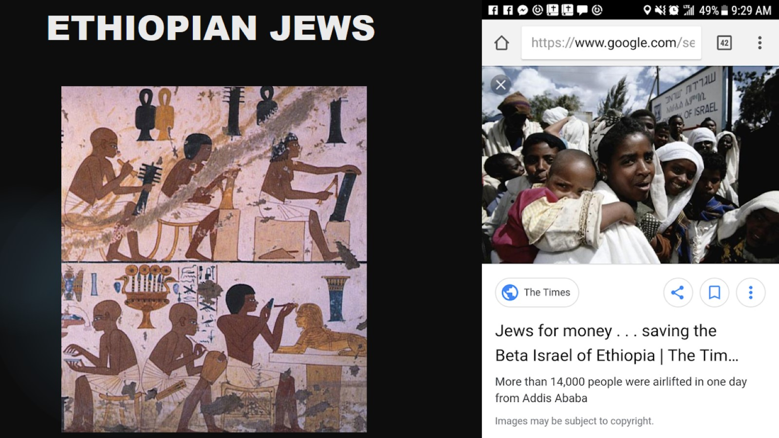
ETHIOPIAN JEWS

Slide 24
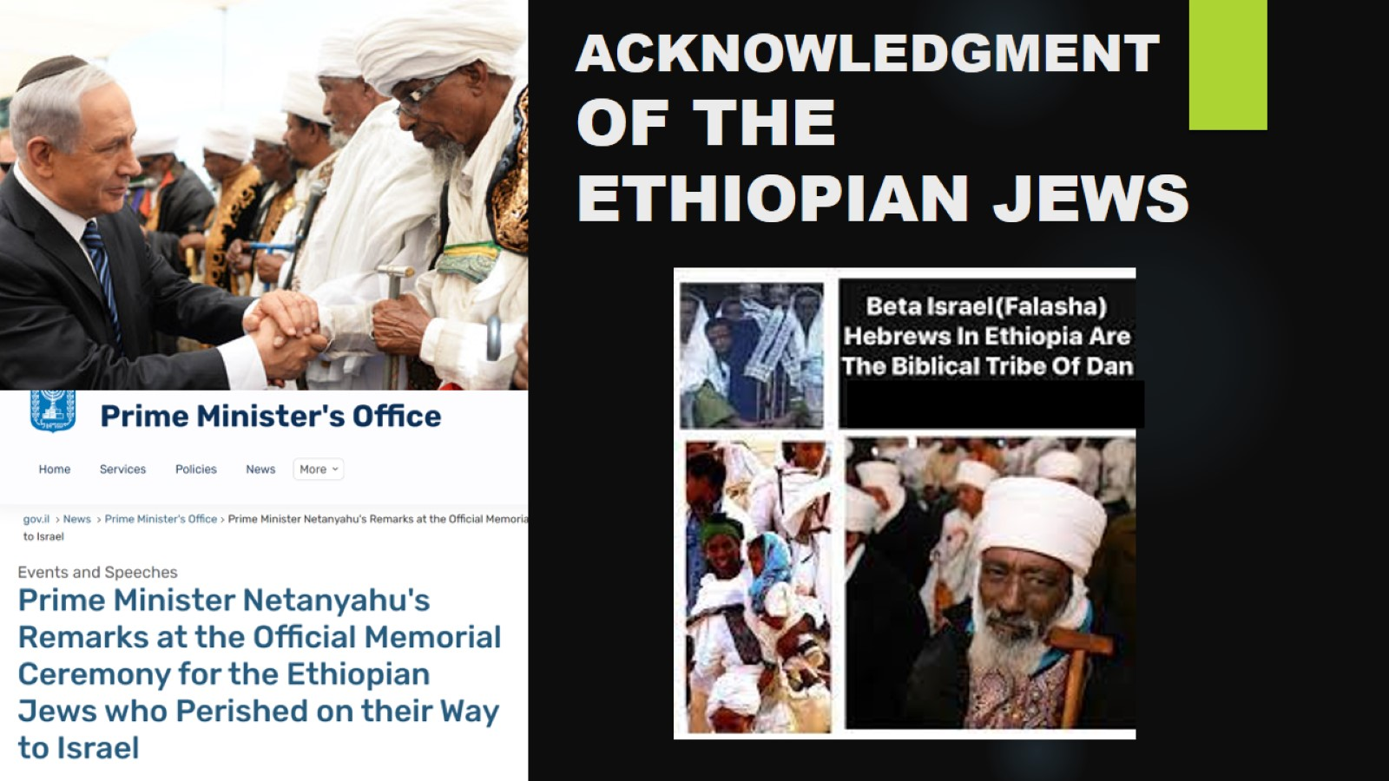
ACKNOWLEDGMENT OF THE ETHIOPIAN JEWS

Slide 25
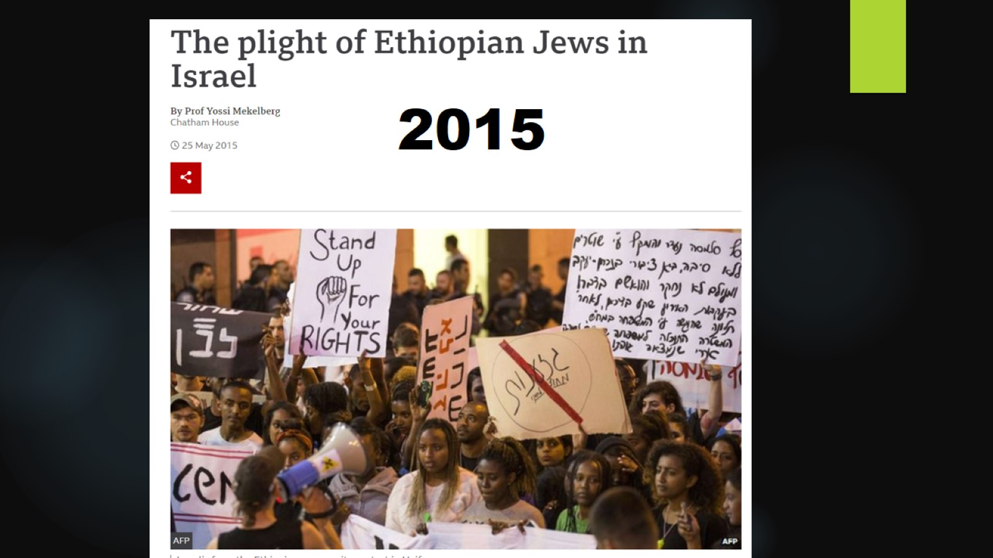

Slide 26
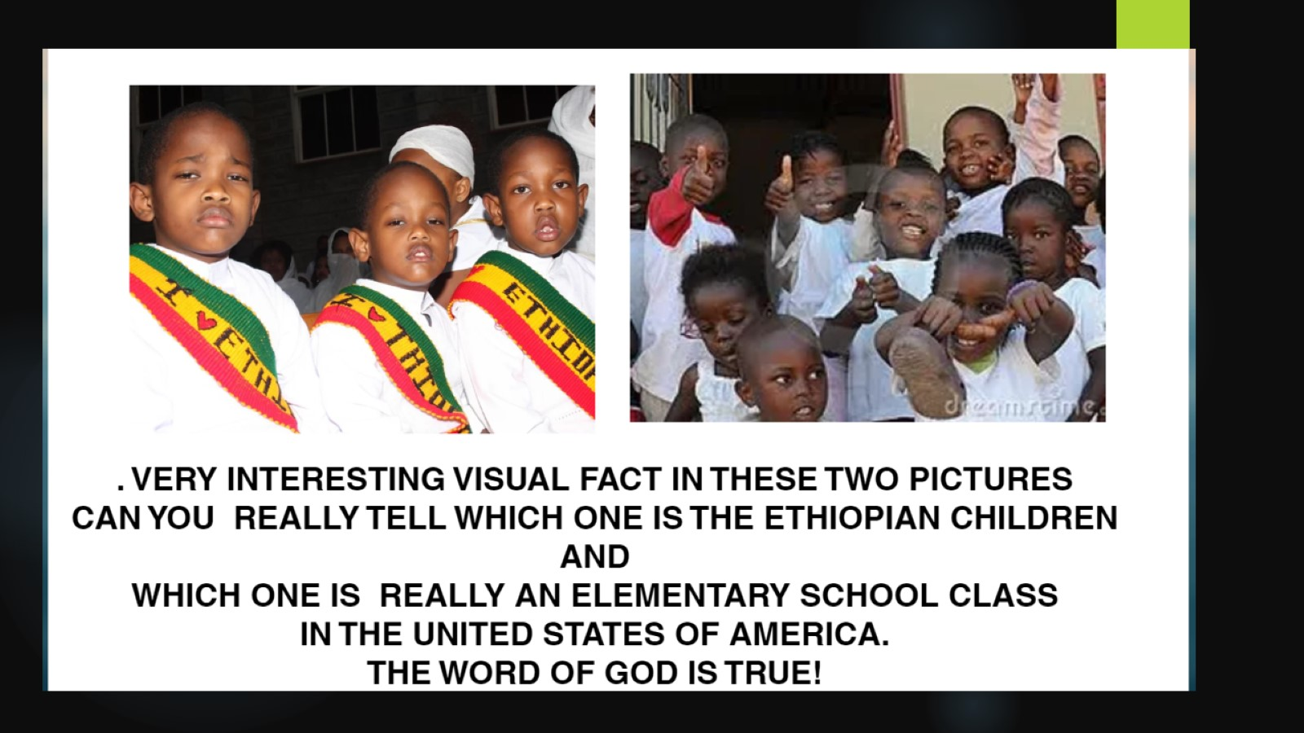

Slide 27
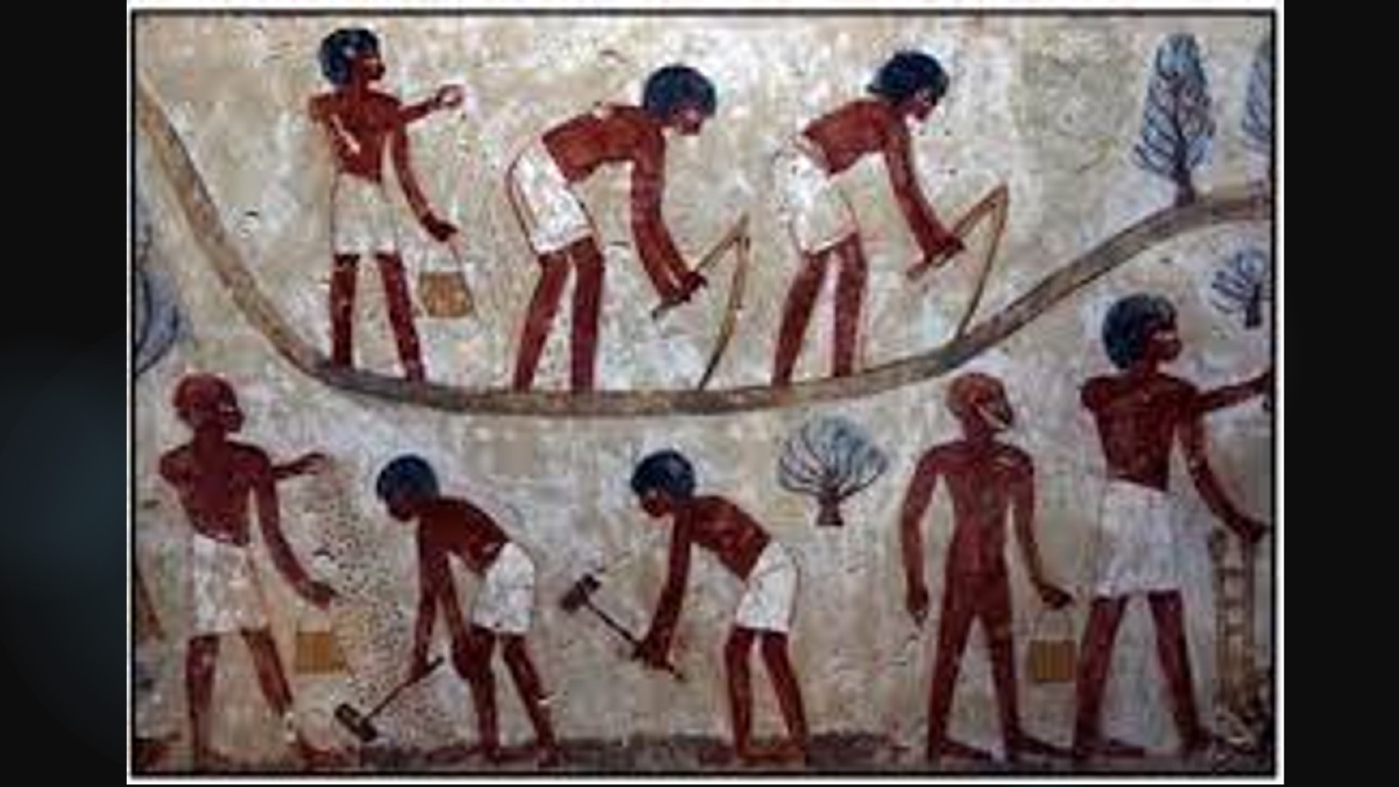

Slide 28
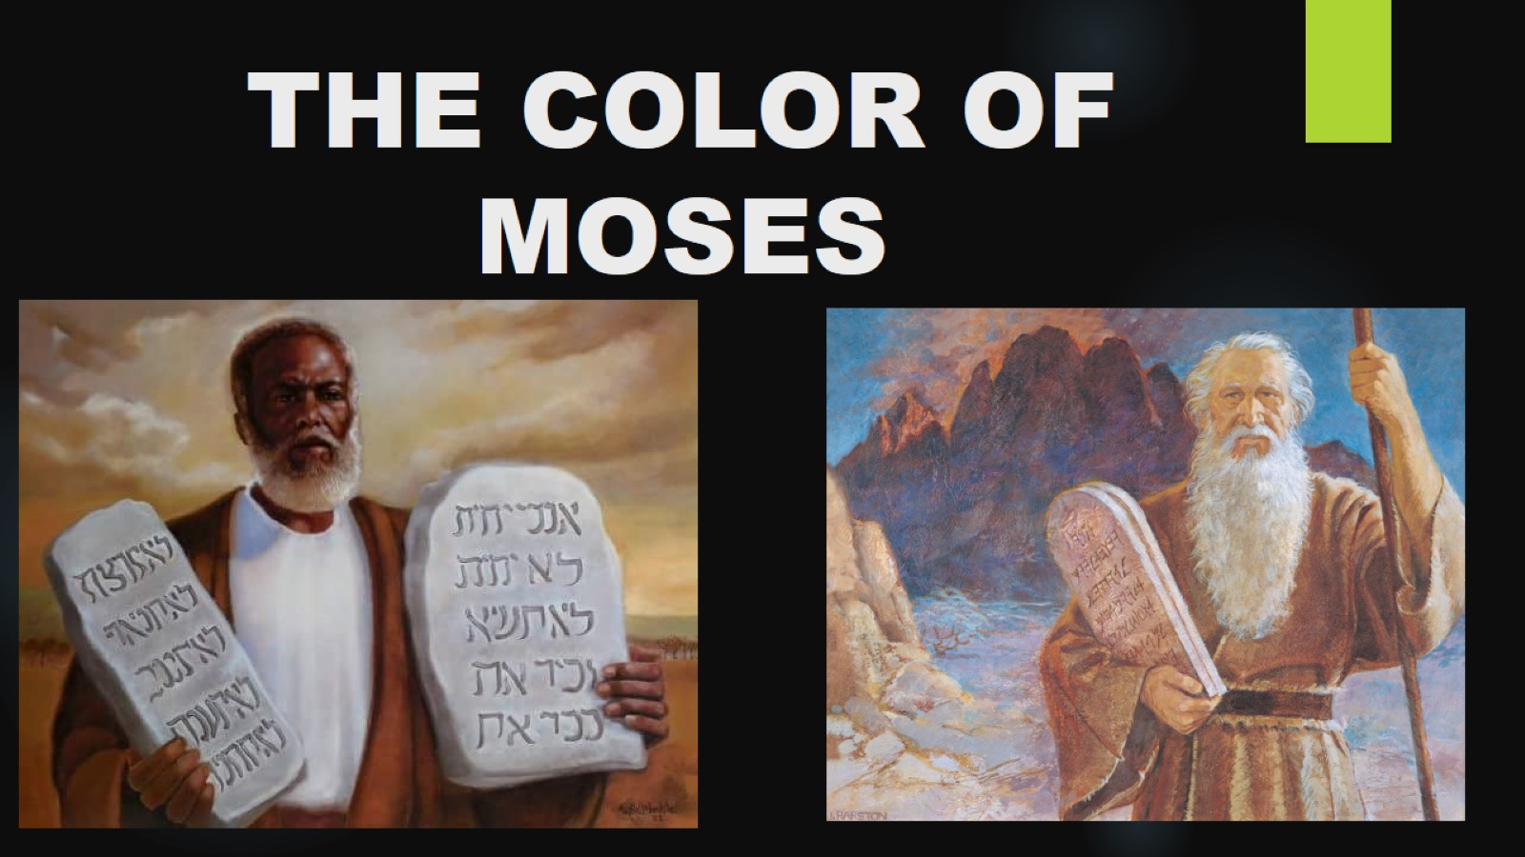
THE COLOR OF MOSES

Slide 29
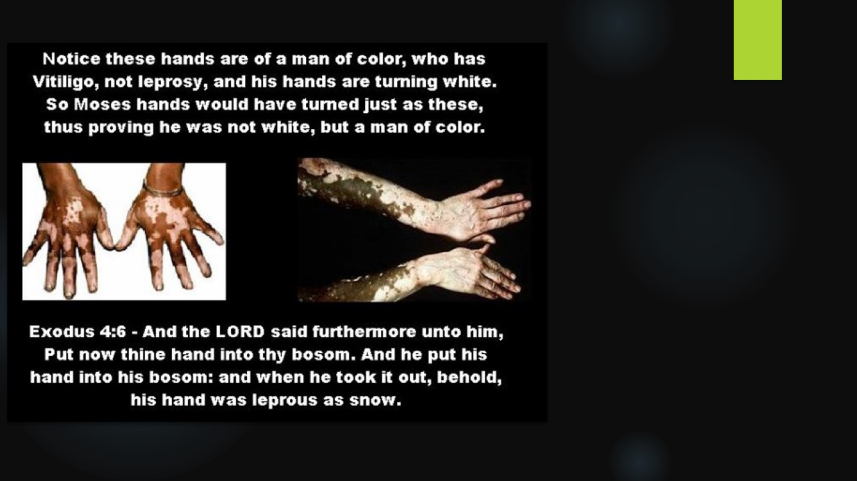

Slide 30
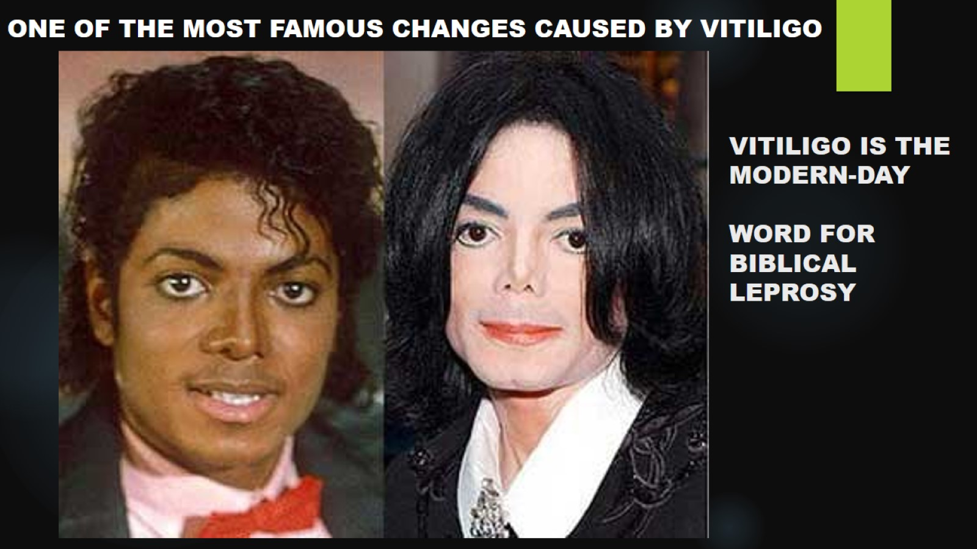
VITILIGO IS THE MODERN-DAY
WORD FOR BIBLICAL LEPROSY

Slide 31
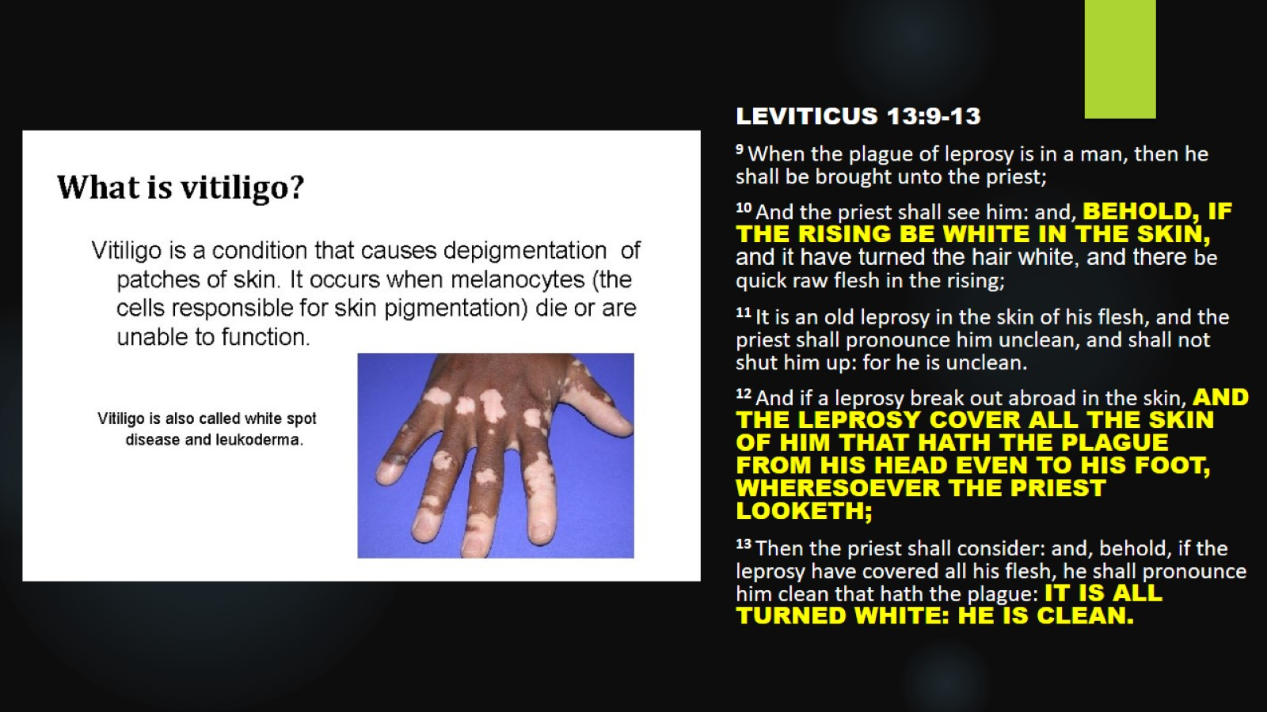

Slide 32
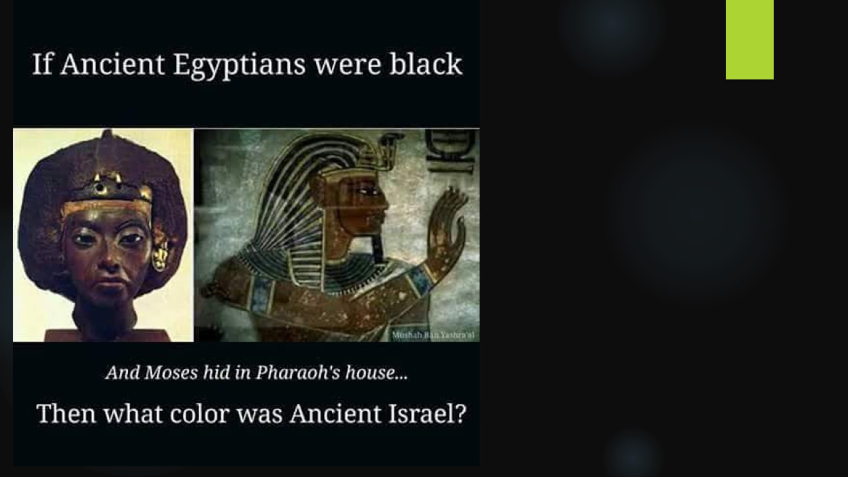

Slide 33
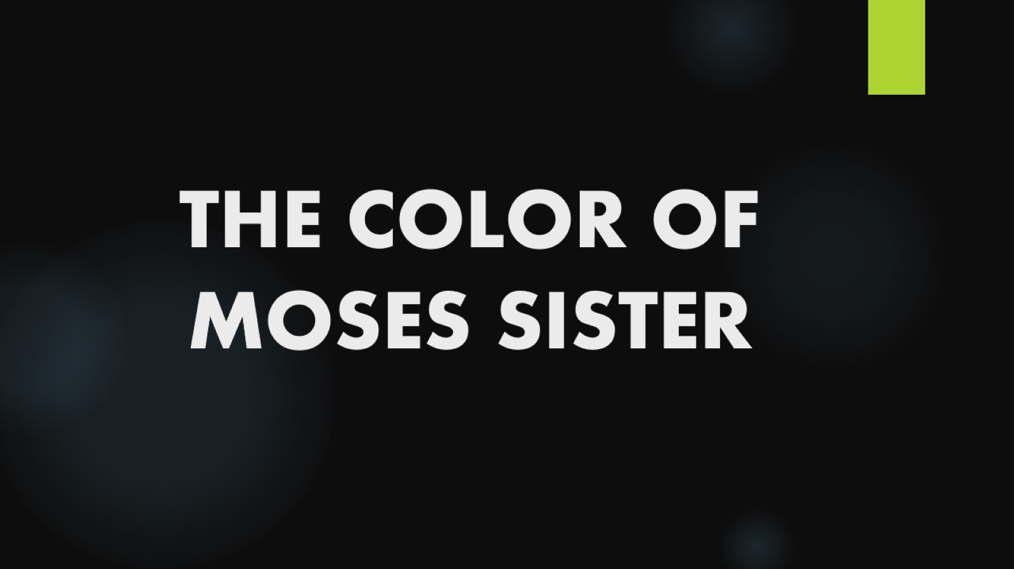
THE COLOR OF MOSES SISTER

Slide 34
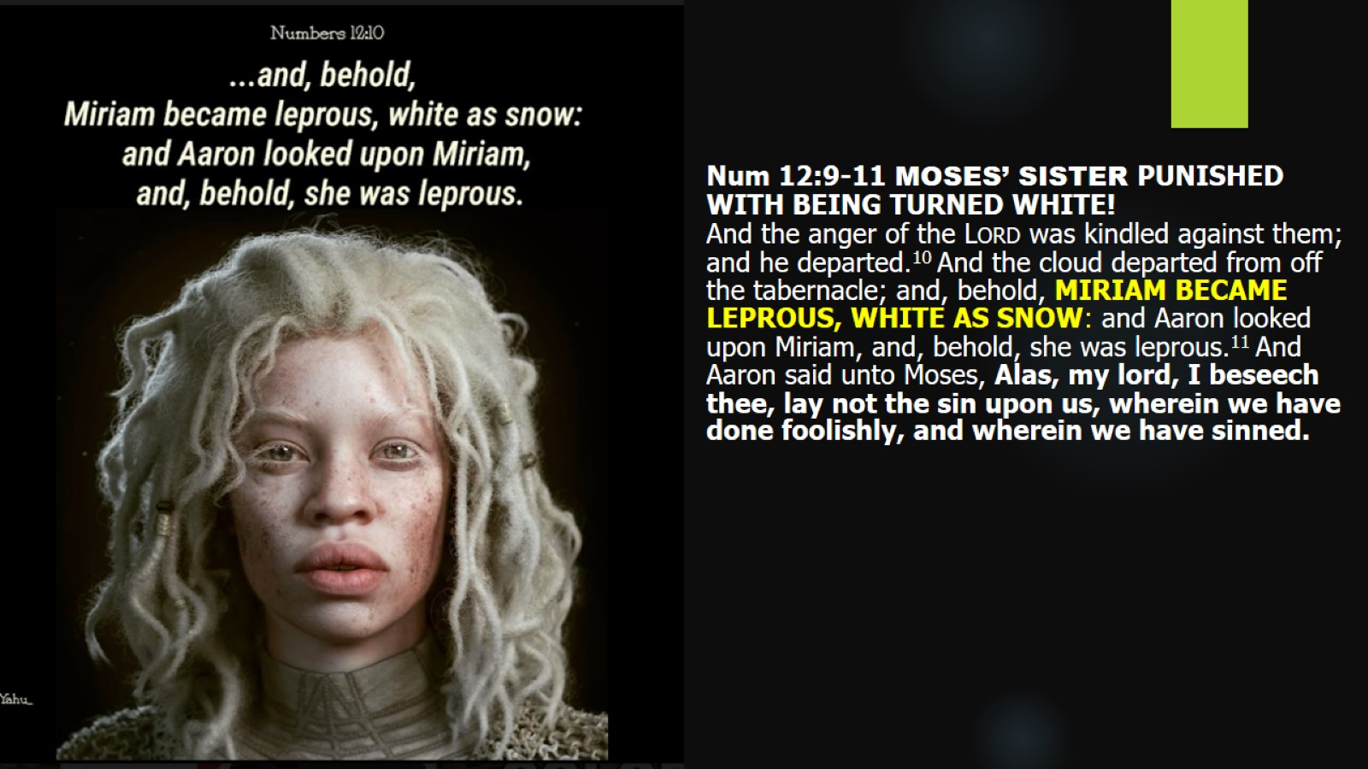

Slide 35
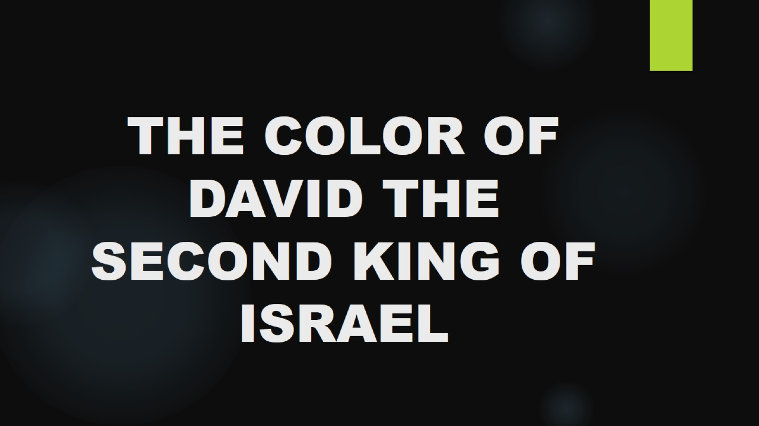
THE COLOR OF DAVID THE SECOND KING OF ISRAEL

Slide 36
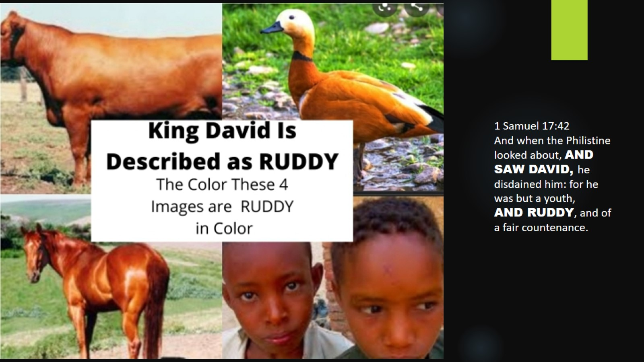

Slide 37
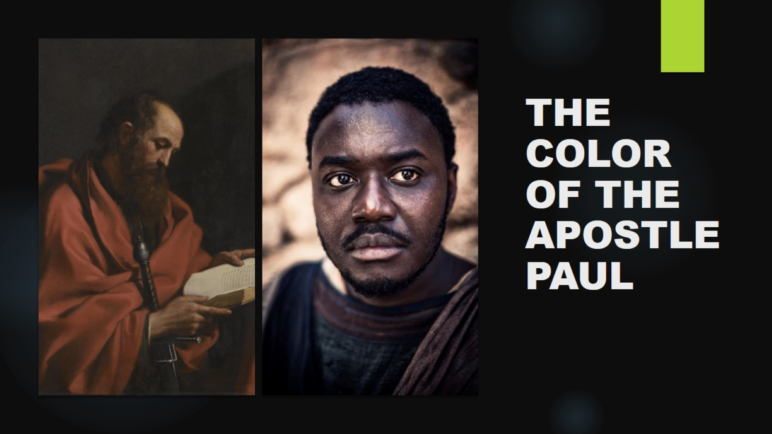
THE COLOR OF THE APOSTLE PAUL

Slide 38
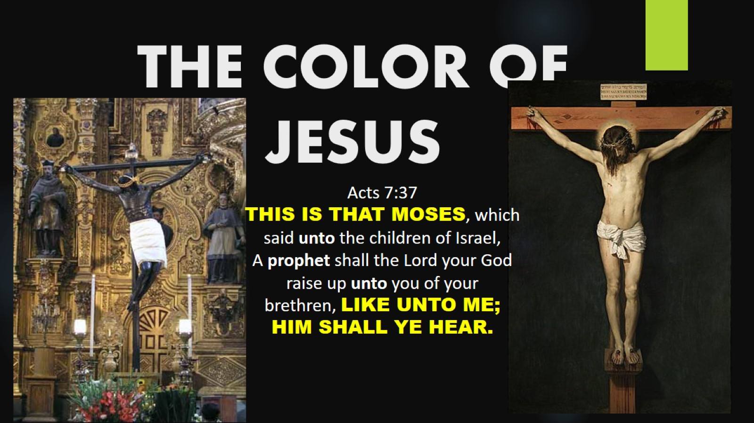
THE COLOR OF JESUS

Slide 39
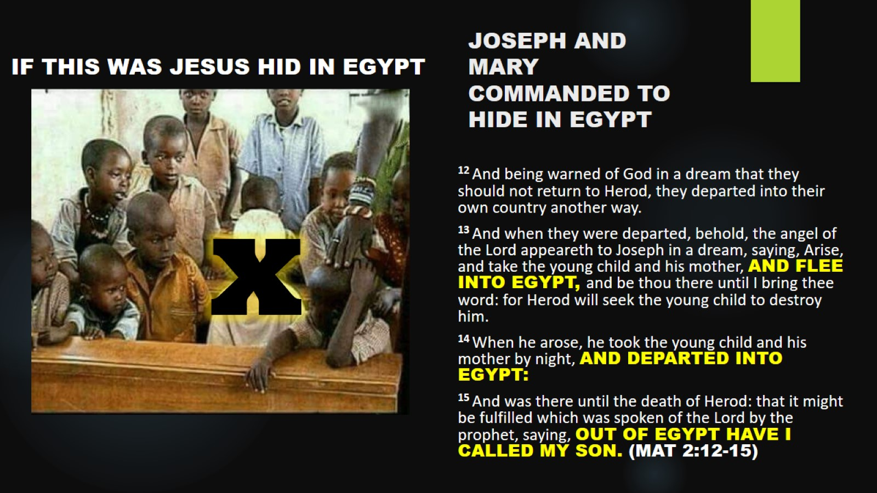
JOSEPH AND MARY COMMANDED TO HIDE IN EGYPT

Slide 40
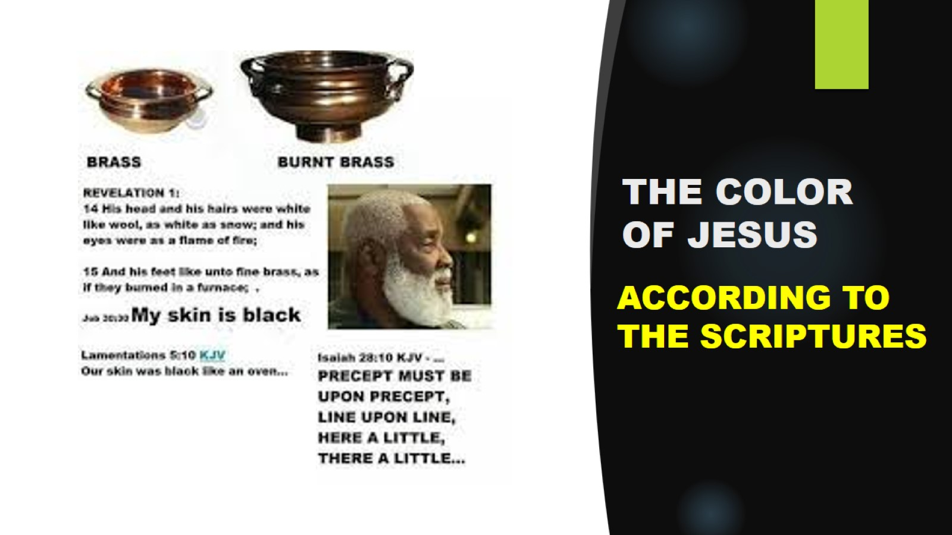
THE COLOR OF JESUS

Slide 41
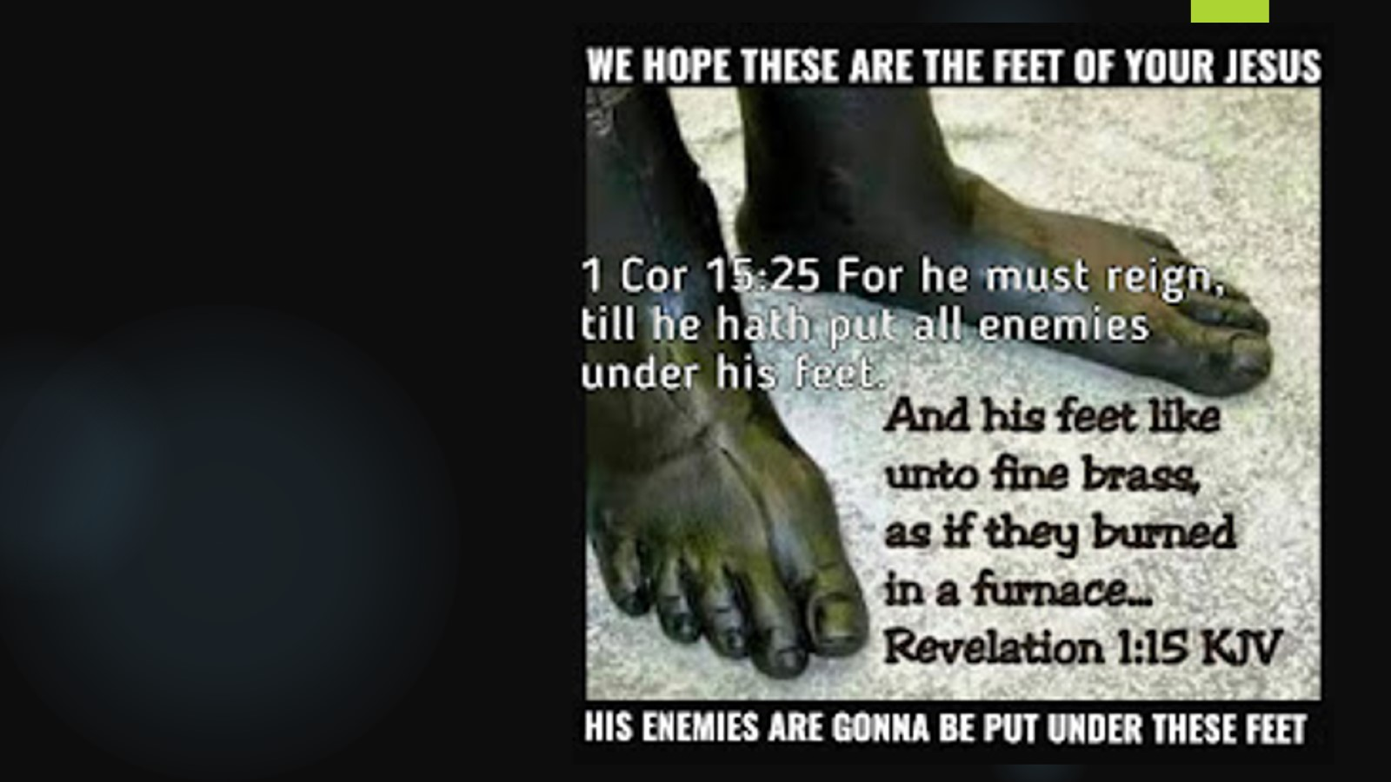

Slide 42
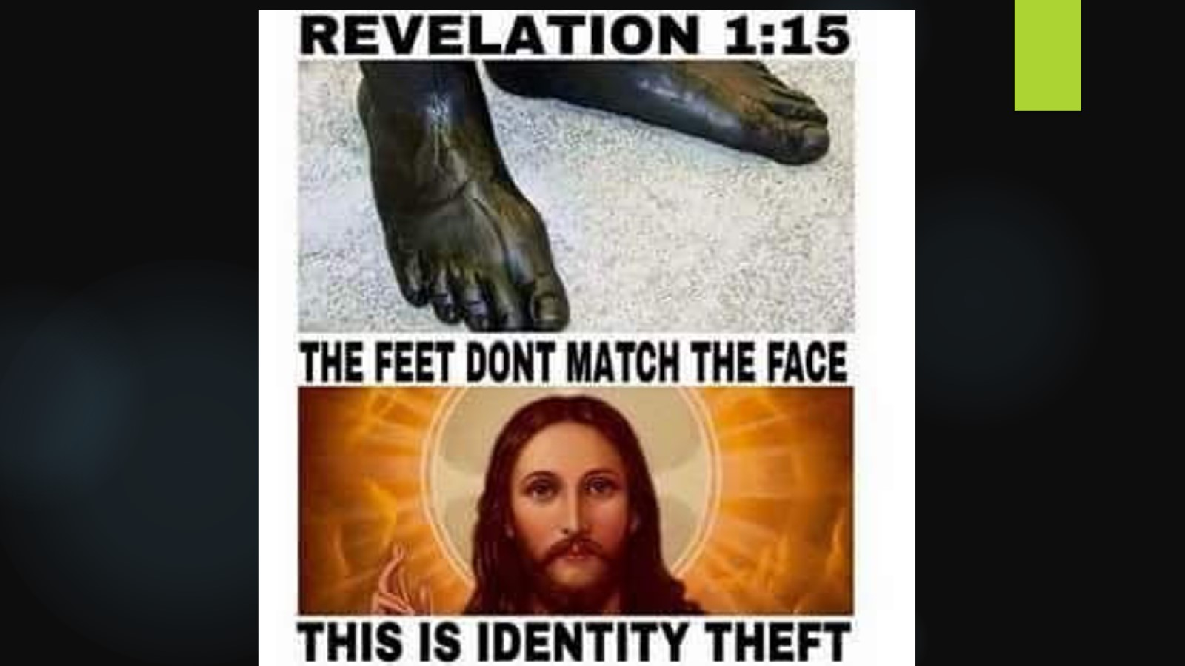

Slide 43
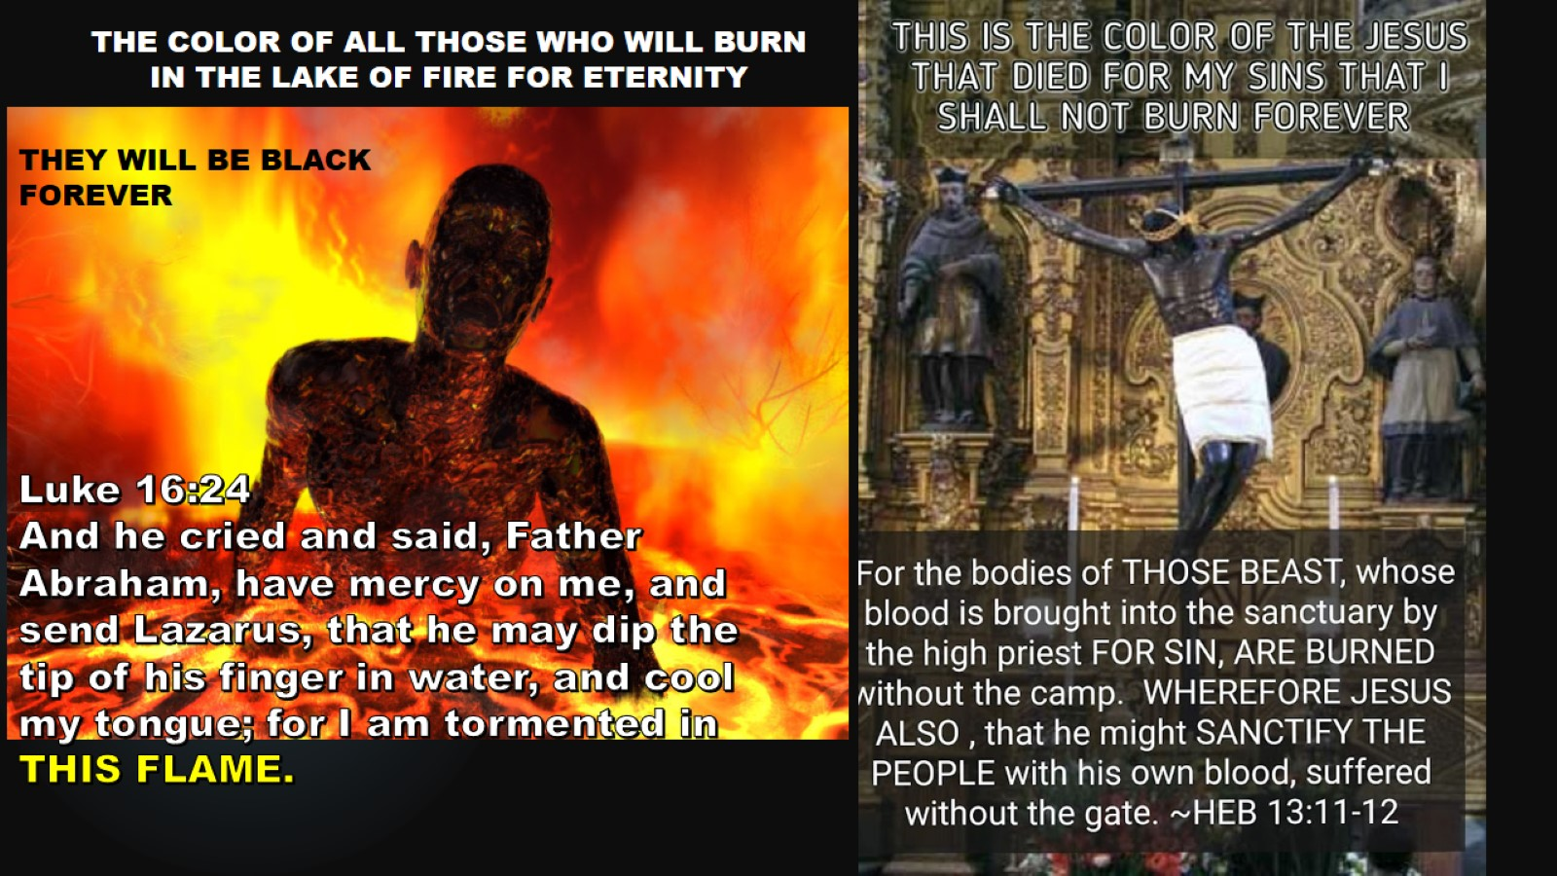

Slide 44


Slide 45
